Slide 1


Slide 2



Slide 3



Slide 4



Slide 5



Slide 6





Slide 7



Slide 8
ALTERNATOR
Constructional details and types of rotors
EMF equation
Synchronous reactance
Armature reaction
Voltage regulation of EMF and MMF methods
Voltage regulation ZPF methods
Synchronizing and parallel operation
Synchronizing power
Change of excitation and mechanical input
Blondel’s theory
Determination of Xd and Xq using slip test.

Slide 9
ALTERNATOR
A synchronous machine is an ac machine in which the rotor moves at a speed, which bears a constant relationship to the frequency of current in the armature winding.
ALTERNATOR SYNCHRONOUS GENERATOR

Slide 10
CONSTRUCTION DETAILS
Stator
Rotor
Armature winding is in stator slots and
the field poles is in the rotor

Slide 11
Construction of synchronous generator depends on the type of prime mover
Types of prime mover
Thermal power - steam turbine
Hydel power - hydraulic turbine
Diesel power
In all the system the frequency should be maintain constant f = P * N f = 50 Hz
120

Slide 12
Generation of single phase and poly phase EMF
When there is a change of flux linkage by a coil, emf is induced in the conductor
For three phase emf generation the winding should be displaced at an angle of 120⁰ with each other.

Slide 13
CONSTRUCTION REQUIREMENTS
Field system
System of conductors
Relative motion between the two
For relative motion
Keep the field system stationary and allowing the system of conductors to rotate
Keep the system of conductors stationary and allowing the field system to rotate

Slide 14
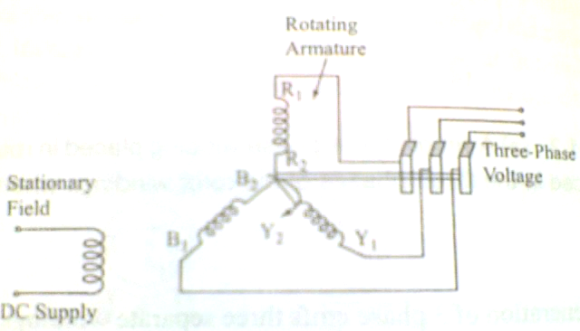
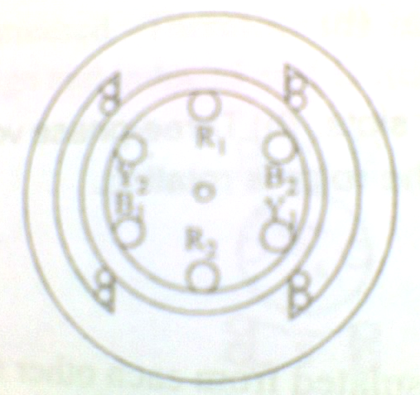
STATIONARY FIELD SYSTEM

Slide 15
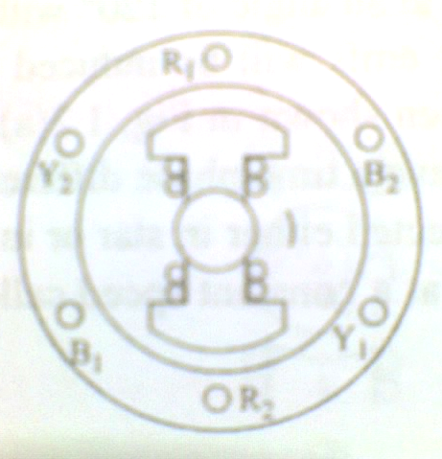
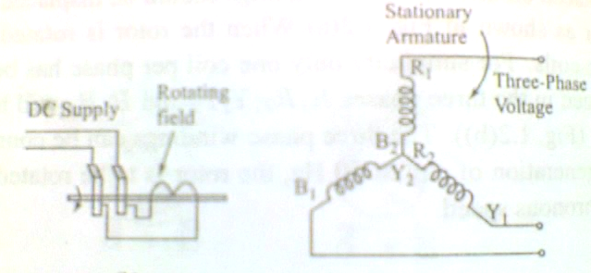
ROTATING FIELD SYSTEM

Slide 16
Advantages of Rotating Field System
Power can be easily supplied to the field
Easier to provide the necessary insulation for the armature
No mechanical stresses in the armature
Improved ventilation arrangement
Stationary connection between the system of conductors and the external load (500 MVA)
Only 2 slip rings are needed
Reduced rotor weight and rotor inertia

Slide 17
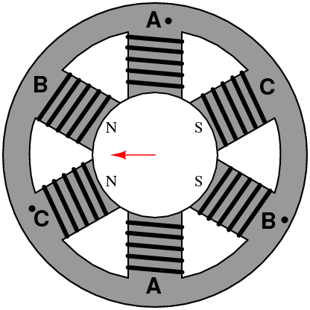


Slide 18
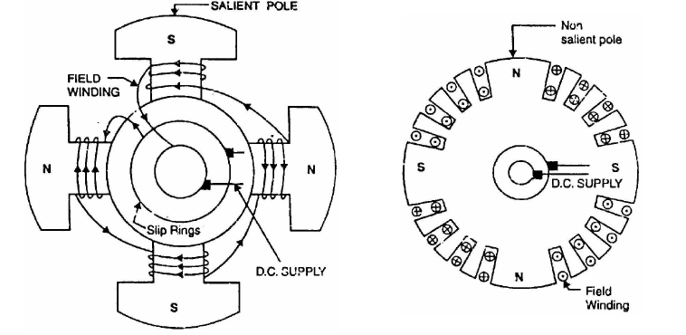
Rotor construction

Slide 19
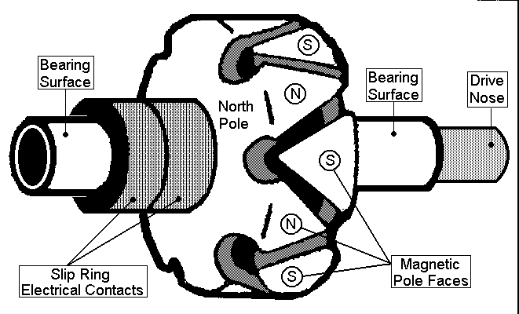

Slide 20
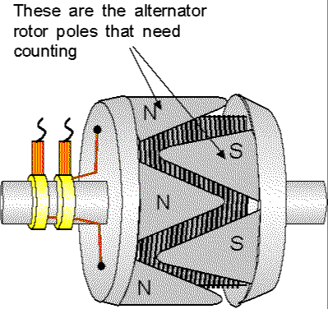

Slide 21
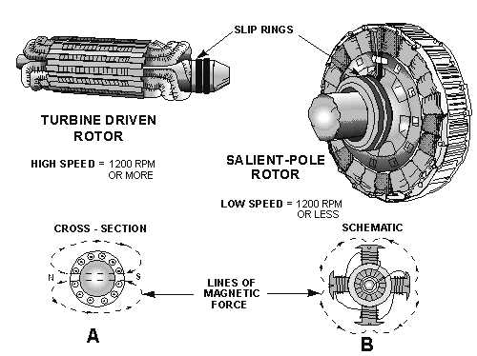

Slide 22
